Slide 1
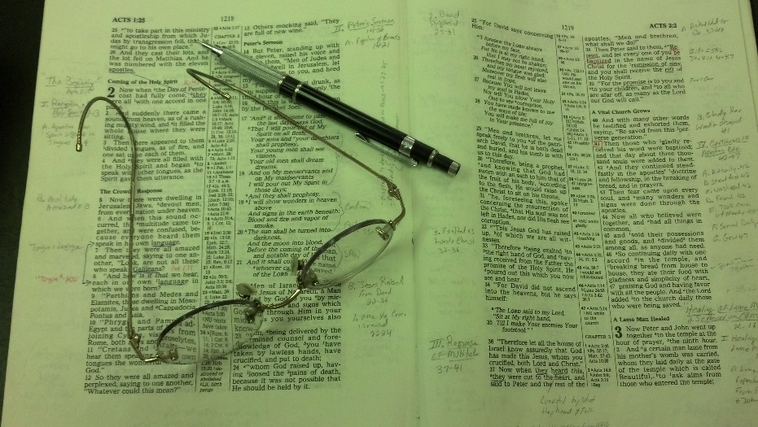
Topics
Tuesday: Things that Encourage
Wednesday: The Peace of God
Thursday: Settled in Complacency
Friday: The Earnest Cry of Bartimaeus

Slide 2








“My Faith” – “Your Faith”
“People of Different Faiths”

Slide 3





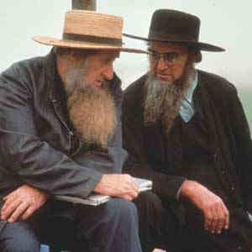




“Different Faiths”

Slide 4
“Different Faiths”

Slide 5
Is One Faith
As Good As Another?

Slide 6



Very Common Concept
One faith is as good as another
Doesn’t make any difference what one believes
Sincerity is all that matters
Attend / Join the church of your choice

Slide 7

Implies
Different beliefs
Different doctrines
Different practices
Different churches
Contradictory
Contradictory
Contradictory
Contradictory

Slide 8
Is One Faith
As Good As Another?

Slide 9
Is One Faith
As Good As Another?
There Is One Faith

Slide 10
There Is One Faith
Bible speaks of “one faith” – not “faiths”
Eph 4:4-6
4 There is one body and one Spirit, just as you were called in one hope of your calling;
5 one Lord, one faith, one baptism;
6 one God and Father of all, who is above all, and through all, and in you all.

Slide 11
There Is One Faith
Bible speaks of “one faith” – not “faiths”
“One faith” means “only one faith”
Eph 4:4-6
4 There is one body and one Spirit, just as you were called in one hope of your calling;
5 one Lord, one faith, one baptism;
6 one God and Father of all, who is above all, and through all, and in you all.
“One Spirit” - Many spirits?
- Only one Spirit?
“One Lord” - Many Lords?
- Only one Lord?
“One God” - Many gods?
- Only one God?
“One Faith” - Many faiths?
- Only one faith?

Slide 12
There Is One Faith
Bible speaks of “one faith” – not “faiths”
“One faith” means “only one faith”
Context of unity

Slide 13
Eph. 4:1-6
1 I, therefore, the prisoner of the Lord, beseech you to walk worthy of the calling with which you were called,
2 with all lowliness and gentleness, with longsuffering, bearing with one another in love,
3 endeavoring to keep the unity of the Spirit in the bond of peace.
4 There is one body and one Spirit, just as you were called in one hope of your calling;
5 one Lord, one faith, one baptism;
6 one God and Father of all, who is above all, and through all, and in you all.
“One faith” is essential to unity!
“Many faiths” – creates division

Slide 14
Is One Faith
As Good As Another?
There Is One Faith
One Can Be Religious & Be Wrong

Slide 15
One Can Be Religious & Be Wrong
Cain’s offering was not accepted

Slide 16
Gen 4:3-5
3 And in the process of time it came to pass that Cain brought an offering of the fruit of the ground to the LORD.
4 Abel also brought of the firstborn of his flock and of their fat. And the LORD respected Abel and his offering,
5 but He did not respect Cain and his offering. And Cain was very angry, and his countenance fell.

Slide 17

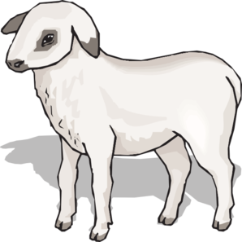

Cain
Abel
Offering:
“Fruit of ground”
Offering:
“firstborn of his flock”
Lord
Did Not Respect
Lord
Respected
Not: “By Faith”
“By Faith”
(Heb. 11:4)
Word of God
(Rom. 10:17)

Slide 18
One Can Be Religious & Be Wrong
Cain’s offering was not accepted
Nadab & Abihu’s sacrifice did not please God

Slide 19
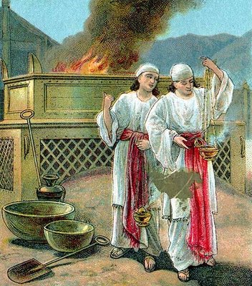
Lev 10:1-2
1 Then Nadab and Abihu, the sons of Aaron, each took his censer and put fire in it, put incense on it, and offered profane fire before the LORD, which He had not commanded them.
2 So fire went out from the LORD and devoured them, and they died before the LORD.
“…offered unauthorized fire…” (NIV)

Slide 20
One Can Be Religious & Be Wrong
Cain’s offering was not accepted
Nadab & Abihu’s sacrifice did not please God
Uzzah’s attempt to “help” the ark angered the Lord

Slide 21
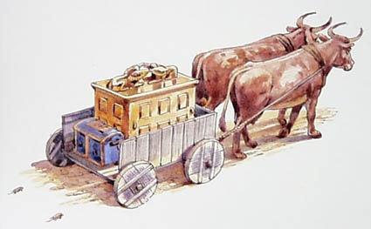
2 Samuel 6:1-11
2 And David arose and went with all the people who were with him from Baale Judah to bring up from there the ark of God, whose name is called by the Name, the LORD of Hosts, who dwells between the cherubim.
3 So they set the ark of God on a new cart, and brought it out of the house of Abinadab, which was on the hill; and Uzzah and Ahio, the sons of Abinadab, drove the new cart.
6 And when they came to Nachon's threshing floor, Uzzah put out his hand to the ark of God and took hold of it, for the oxen stumbled.
7 Then the anger of the LORD was aroused against Uzzah, and God struck him there for his error; and he died there by the ark of God.

Slide 22
One Can Be Religious & Be Wrong
Cain’s offering was not accepted
Nadab & Abihu’s sacrifice did not please God
Uzzah’s attempt to “help” the ark angered the Lord
Believers in Christ can be wrong

Slide 23
Matt. 7:21-23
21"Not everyone who says to Me, 'Lord, Lord,' shall enter the kingdom of heaven, but he who does the will of My Father in heaven.
22 "Many will say to Me in that day, 'Lord, Lord, have we not prophesied in Your name, cast out demons in Your name, and done many wonders in Your name?'
23 "And then I will declare to them, 'I never knew you; depart from Me, you who practice lawlessness!'

Slide 24
Is One Faith
As Good As Another?
There Is One Faith
One Can Be Religious & Be Wrong
Warning About False Teachers

Slide 25
Warning About False Teachers
False prophets come in sheep’s clothing (Matt. 7:15-20)
Blind lead the blind & both fall (Matt. 15:14)
Many deceived by false prophets (Matt. 24:11)
False teachers today – as were false prophets of old (2 Pet. 2:1-3)
Many false prophets in world (1 John 4:1)
If there is such a thing as false prophets
Then, one faith is not as good as another!

Slide 26
Is One Faith
As Good As Another?
There Is One Faith
One Can Be Religious & Be Wrong
Warning About False Teachers
Truth Is Contrasted To Error

Slide 27
Truth Is Contrasted To Error
Truth is essential:
  To be free (John 8:32)
  To be saved (2 Thess. 2:10-12)
  To be purified (1 Pet. 1:22)
Error is not of God - destroys
  Contrasted to truth (1 John 4:1, 6)
  Leads astray (2 Pet. 3:17)

Slide 28
Is One Faith
As Good As Another?
There Is One Faith
One Can Be Religious & Be Wrong
Warning About False Teachers
Truth Is Contrasted To Error
Sincerity Is Not Enough

Slide 29
Sincerity Is Not Enough
Possible to believe a lie
  Young prophet believe lie – punished (1 Kings 13)

Slide 30
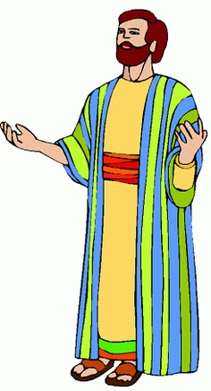

Believing A Lie
1 Kings 13
Truth:
Do not eat bread
Do not drink water
Do not return
by the same way
Lie:
“Bring him back to your
house, that he
may eat bread
and drink water.”

Slide 31
Sincerity Is Not Enough
Possible to believe a lie
  Young prophet believe lie – punished (1 Kings 13)
  Those who believe a lie – perish (2 Thess. 2:10-12)

Slide 32
2 Thess. 2:10-12
Lie Truth
Deceived (v.10)
Not love truth (v. 10)
Deluded (v. 11)
Believe lie (v. 11)
Not believe truth (v. 12)
Pleasure in unright. (v. 12)
Love truth (v. 10)
Believe truth (v. 12)
Perish (v. 10)
Condemned (v. 12)
Saved (v. 10)

Slide 33
Sincerity Is Not Enough
Possible to believe a lie
  Young prophet believe lie – punished (1 Kings 13)
  Those who believe a lie – perish (2 Thess. 2:10-12)
Paul was sincere – but wrong (Acts 23:1)
Way seems right – but is wrong (Prov. 14:12)

Slide 34
Is One Faith
As Good As Another?
There Is One Faith
One Can Be Religious & Be Wrong
Warning About False Teachers
Truth Is Contrasted To Error
Sincerity Is Not Enough
Absurdity Of One Being As Good As Another

Slide 35
Absurdity Of One Being As Good As Another
God is divided (cf. 1 Cor. 1:12-13)
If 50 people can have different faiths, then 1 person can have different faiths
Direct opposite doctrines / practices are equal
We can do anything we want in religion

Slide 36
Is One Faith
As Good As Another?
There Is One Faith
One Can Be Religious & Be Wrong
Warning About False Teachers
Truth Is Contrasted To Error
Sincerity Is Not Enough
Absurdity Of One Being As Good As Another

